Slide 1
Chapter 6
Aggregate Supply and the Phillips Curve

Slide 2
Introduction
Further develop the AS side of the economy; examine the dynamic adjustment process from the short to the long run
The price-output relationship is based upon links between wages, prices, employment, and output
Link between unemployment and inflation = Phillips Curve

Slide 3
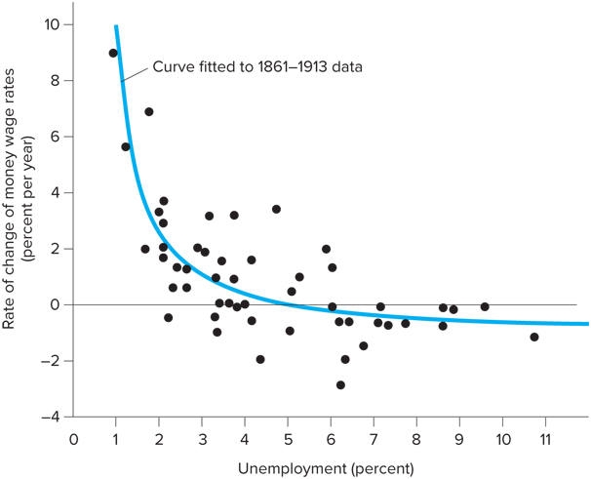
The Phillips Curve
In 1958 A.W. Phillips published a study of wage behavior in the U.K. between 1861 and 1957
There is an inverse relationship between the rate of unemployment and the rate of increase in money wages
From a policymaker’s perspective, there is a tradeoff between wage inflation and unemployment

Slide 4
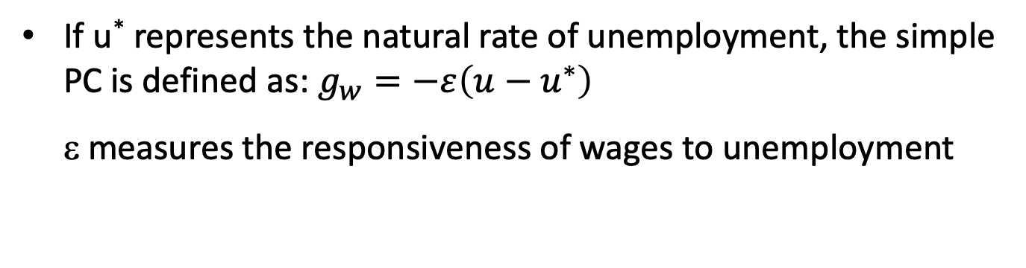
The Phillips Curve
g_{w} = rate of wage inflation, then
If u* represents the natural rate of unemployment, the simple PC is defined as: $g_{w}=−ε\left(u−u^{∗}\right)$
ε measures the responsiveness of wages to unemployment
Wages are falling when u > u* and rising when u < u*
(u - u*) is called the unemployment gap

Slide 5
The Phillips Curve
Suppose the economy is in equilibrium with prices stable and unemployment at the natural rate
If money supply increases by 10%, wages and prices must increase by 10% for the economy to return to equilibrium
To see why this is so, rewrite the previous equation in terms of current and past wage levels:
For wages to rise above previous levels, u must fall below the natural rate

Slide 6
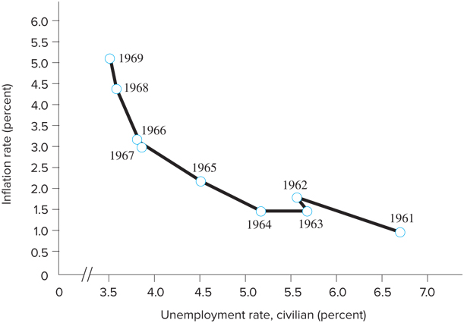
The policy tradeoff
PC quickly became a cornerstone of macroeconomic policy analysis since it suggests that policy makers could choose different combinations of u and Π
In reality the tradeoff between u and Π is a short run phenomenon
Tradeoff disappears as AS becomes vertical

Slide 7
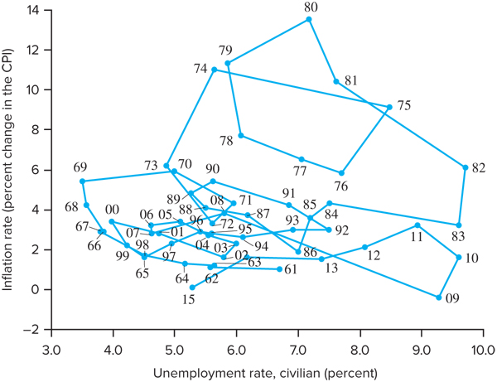
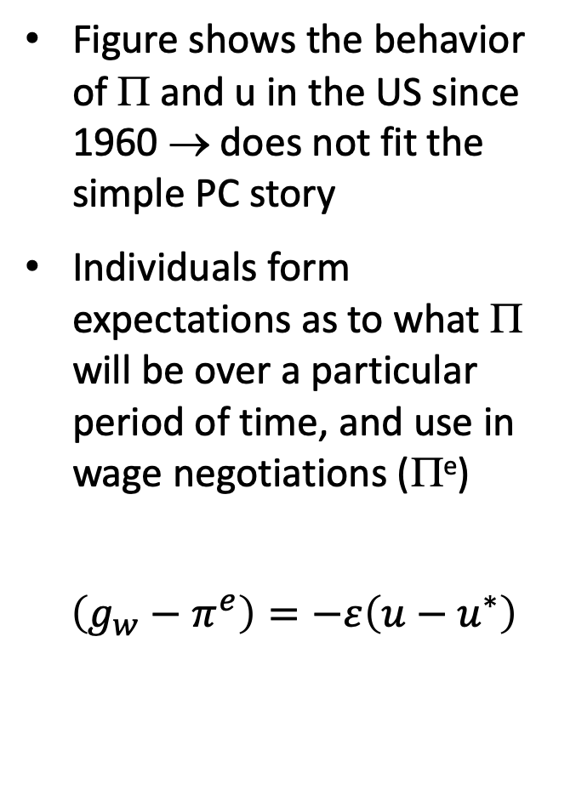
Inflation Expectations-Augmented Phillips Curve
Figure shows the behavior of Π and u in the US since 1960 → does not fit the simple PC story
Individuals form expectations as to what Π will be over a particular period of time, and use in wage negotiations (Π^{e})
$$\left(g_{w}−π^{e}\right)=−ε\left(u−u^{∗}\right)$$

Slide 8
Inflation Expectations-Augmented Phillips Curve
If maintaining the assumption of a constant real wage, W/P, actual Π will equal wage inflation
The equation for the modern version of the PC, the expectations augmented PC, is:
NOTE:
u = u* when Π^{e} = Π

Slide 9
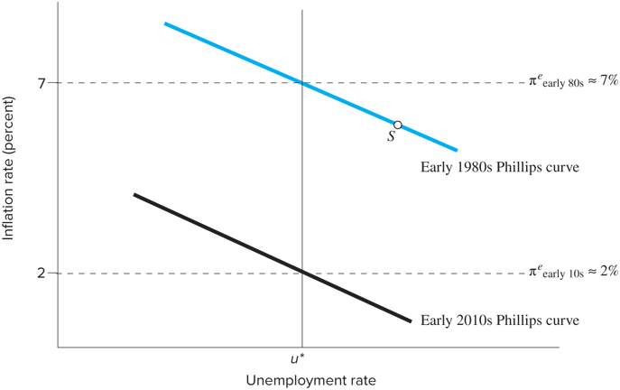
Inflation Expectations-Augmented Phillips Curve
The modern PC intersects the natural rate of u at the level of expected inflation
The height of the PC depends upon Π^{e}
Changes in expectations shifts the curve up and down

Slide 10
Inflation Expectations-Augmented Phillips Curve
Demand-Pull Inflation:
A move along the Philips Curve
When high AD moves the economy up, and to the left along the PC, Π results
If Π persists, people adjust their expectations upwards, and move to higher PC
Cost-Push Inflation:
A shift in the Philips Curve
Can you show it graphically???

